Slide 1
Mathematics in Context – The Future of Mathematics Education
Dr Toh Tin Lam
Associate Professor
National Institute of Education
Nanyang Technological University, Singapore

Slide 2
Outline of Presentation
Mathematics Education in Singapore
Mathematics in Context
Application of Mathematics in the Real World
Making Decisions with Mathematics
Conclusion

Slide 3
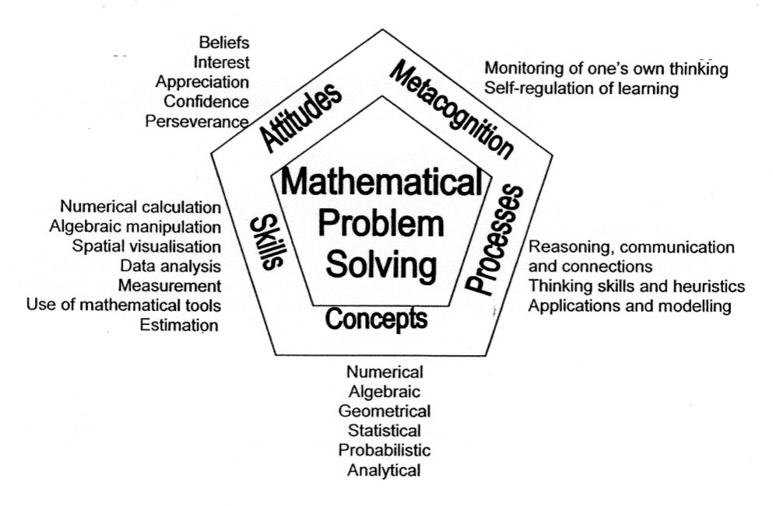
Mathematics Education in Singapore
Notes:
Singapore pentagon framework

Slide 4
Mathematics Education in Singapore
Aims and Objective of Mathematics Curriculum
Acquire concepts and skills for continuous learning in mathematics and to support learning in other subjects;
Develop thinking, reasoning, communication, application and metacognitive skills through a mathematical approach to problem solving;
Connect ideas within and between mathematics and other subjects through applications of mathematics;
Build confidence and foster interest in mathematics.

Slide 5
Mathematics Education in Singapore
Students generally score very well in high-stake national examinations
Students perform very well in international comparative studies (TIMSS and PISA)
Do students see the relevance of math in real-life?
Singapore students have no difficulty learning mathematics?
Some of the problems of Singapore students in learning mathematics?

Slide 6
Mathematics Education in Singapore
Revisions of the mathematics curriculum;
Problem solving (PS) at the center of the curriculum framework;
Modifications to the sub-components of the five attributes of PS (represented by the five sides of the pentagon);
Modification as fine-tuning

Slide 7
Mathematics Education in Singapore
Since 2001, emphasize the application of mathematics to solve real-world problem at the primary level;
At Secondary school level in 2007 emphasis on application and modeling;
Solving real-world tasks – application of mathematics in the real world.

Slide 8
Mathematics Education in Singapore
Learning experience should provide opportunities for students to
enhance conceptual understanding through use of various mathematical tools, including ICT tools;
apply concepts and skills learnt in real-world context;
communicate their reasoning and connections through various mathematical tasks and activities;
build confidence and foster interest in mathematics (Ministry of Education).

Slide 9
Mathematics in Context
Mathematics should be taught in context
Emphasis should be made on application of mathematics in real life.

Slide 10
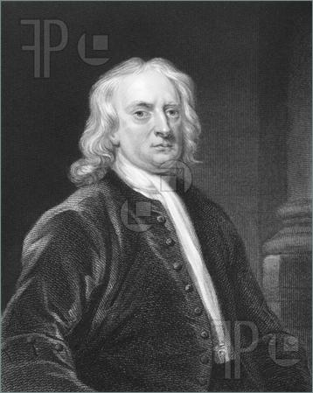
Mathematics in Context
Mathematics always exists as application until the 18th century… emergence of “pure mathematics”.
Pure mathematics – study of
abstract concepts irrespective
of the world and applications
in the world

Slide 11
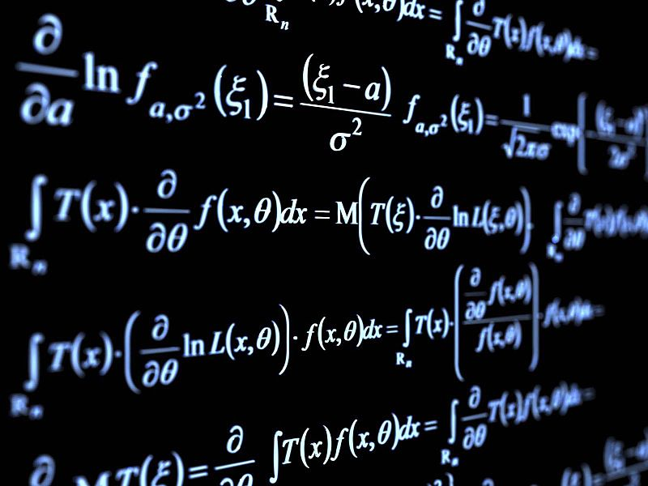
Mathematics in Context
Even the study of pure mathematics is inspired from the world, and is an attempt to generalize social and real-world phenomena

Slide 12
Mathematics in Context
When a child first learns mathematics …
Notes:
Mathematics is first learnt in context, not in isolation

Slide 13
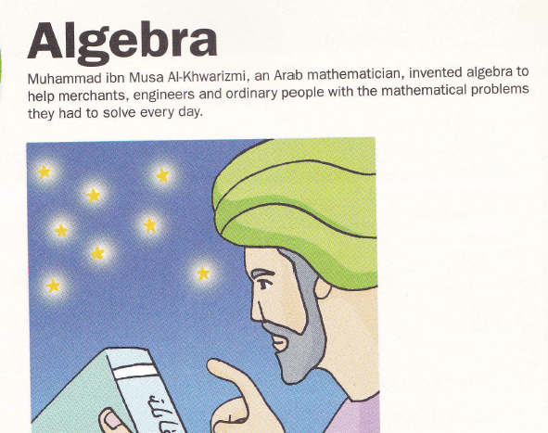
Mathematics in Context
Algebra – abstract?
Notes:
Even algebra is discovered to solve real world problem, not out of context

Slide 14
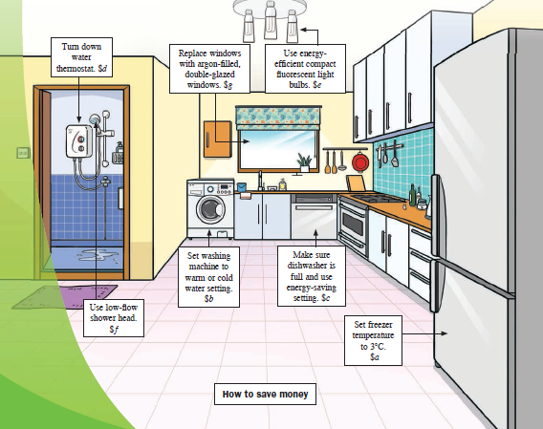
Mathematics in Context
Algebra – abstract?
Notes:
This is an example of using algebra to solve real-world problem.

Slide 15
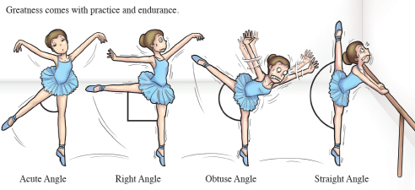
Mathematics in Context
All mathematics concepts are motivated from real-world problems…

Slide 16
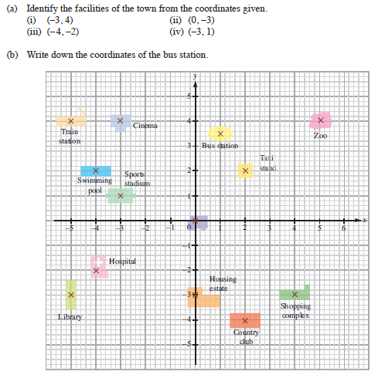
Mathematics in Context
Notes:
E.g. cartesian coordinates can be put in context and interesting games or treasure hunt can be designed.

Slide 17
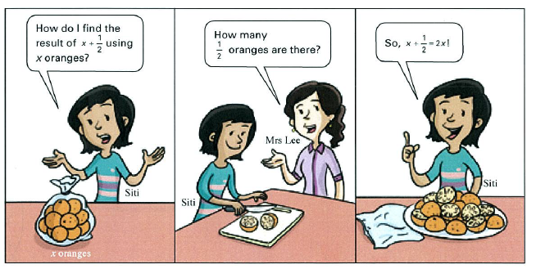
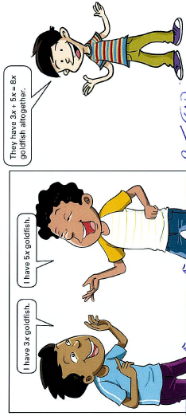
Mathematics in Context
Notes:
Some math concepts are best explained or illustrated using context

Slide 18
Mathematics in Context
Some abstract concepts / processes:
What is the difference between x and x + 1?
We could see that x + 1 is the process of adding 1 to the variable x.
We could also see that x + 1 denotes the concept of 1 more than x.
Not easy for students to switch between the mathematical process and mathematical concept.
Notes:
Abstract processes and concepts can be contextualized.

Slide 19
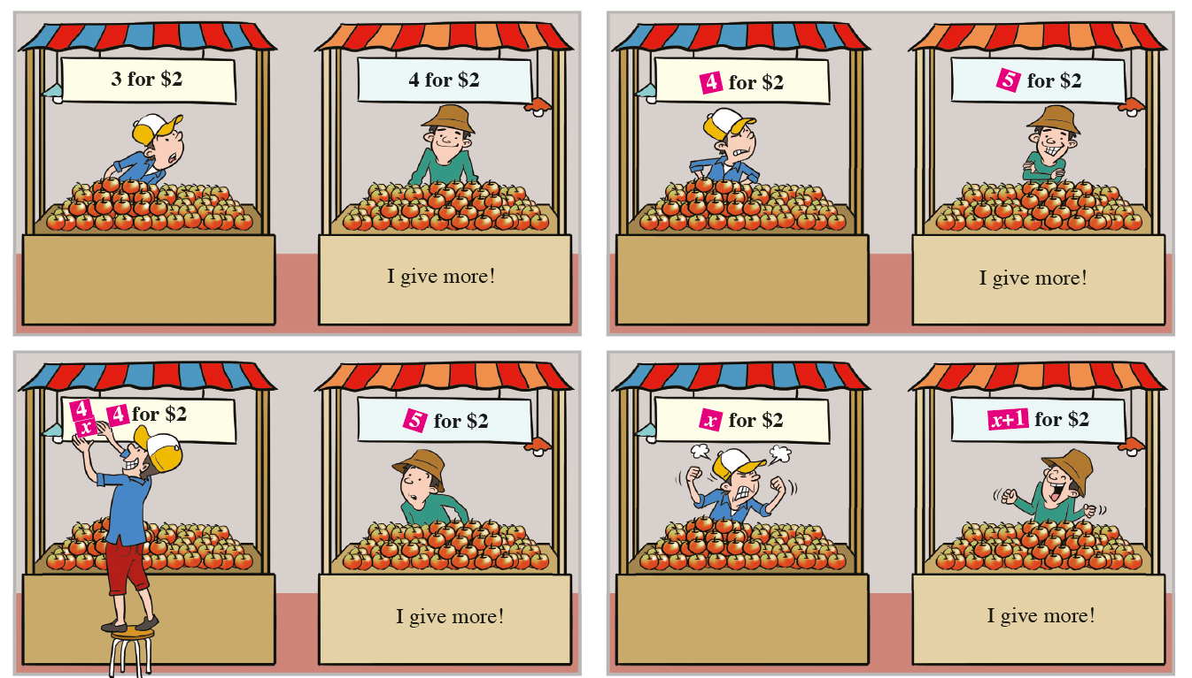
Mathematics in Context
…and some humor
Notes:
Humor can be introduced into teaching mathematics

Slide 20
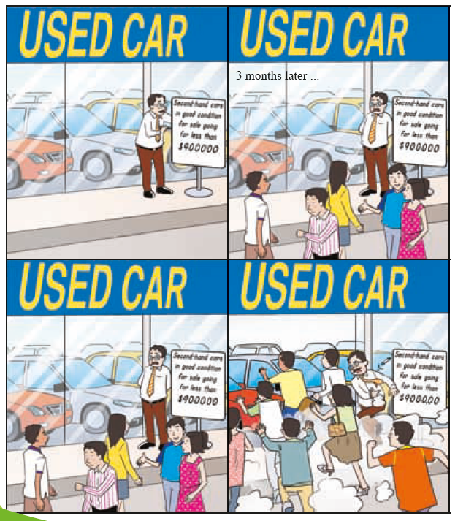
Mathematics in Context

Slide 21
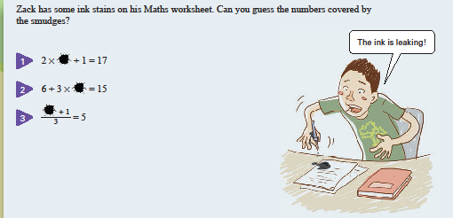
Mathematics in Context
Contextualize mathematical concept
Notes:
Algebraic equation can be contextualized to make sense for students. Not just involving letters, but involves finding unknowns.

Slide 22
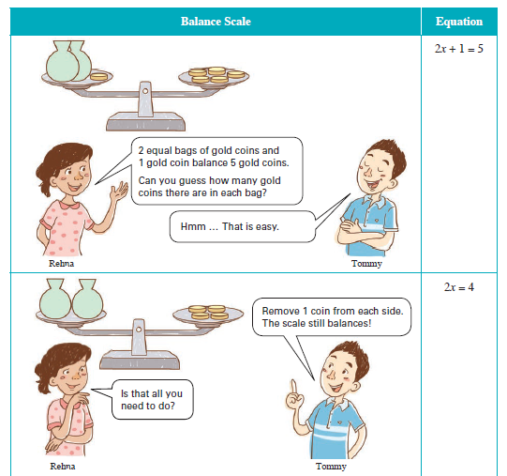
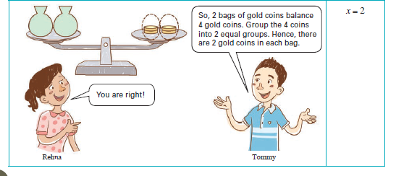
Mathematics in Context
Contextualize mathematical procedure 2x + 1 = 5
Notes:
The procedure of solving algebraic equation can be made meaningful.

Slide 23
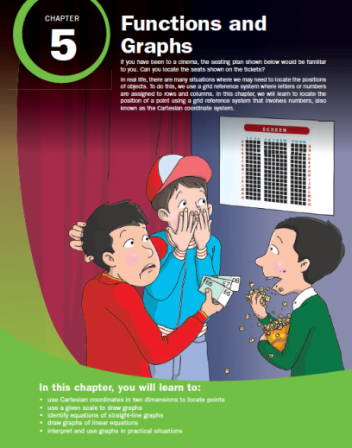

Slide 24
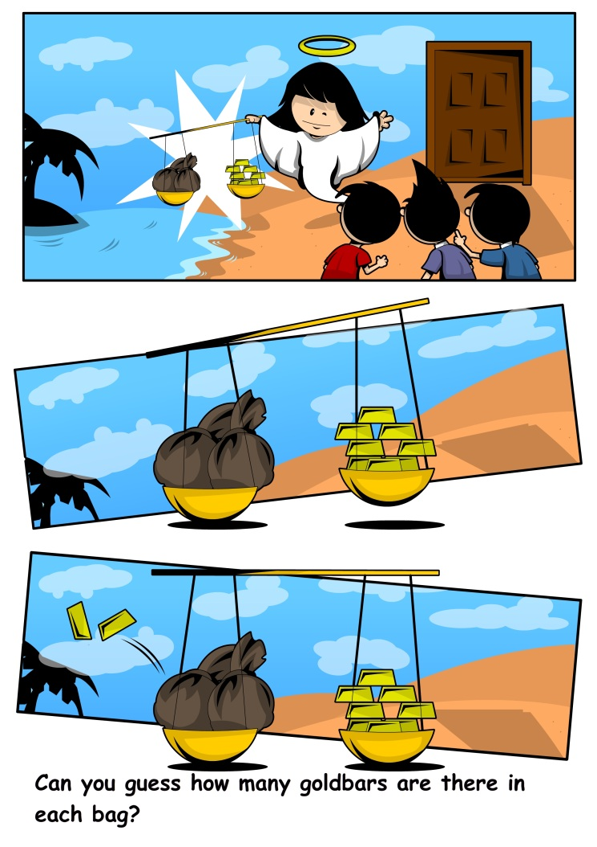
Mathematics in Context
Develop story of three boys’ adventure in Algebra Land…

Slide 25
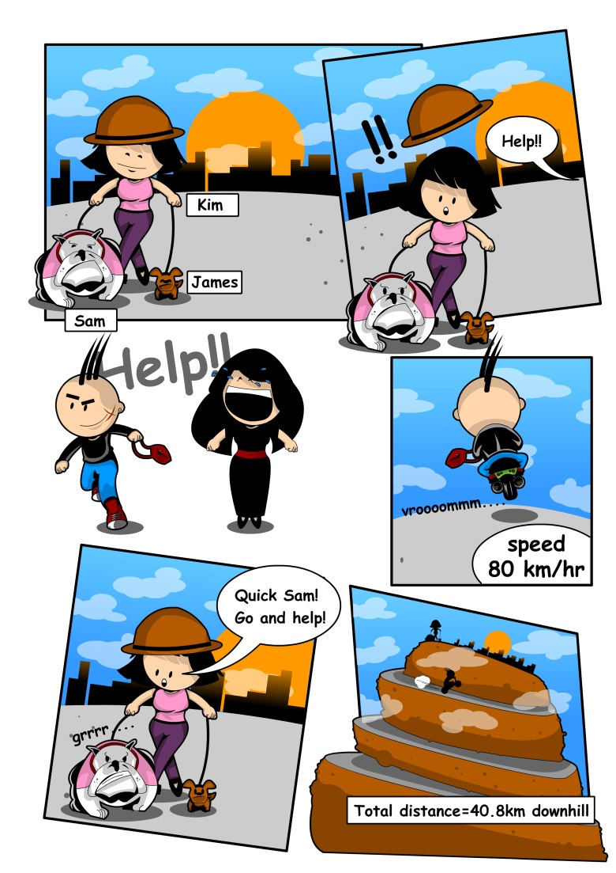
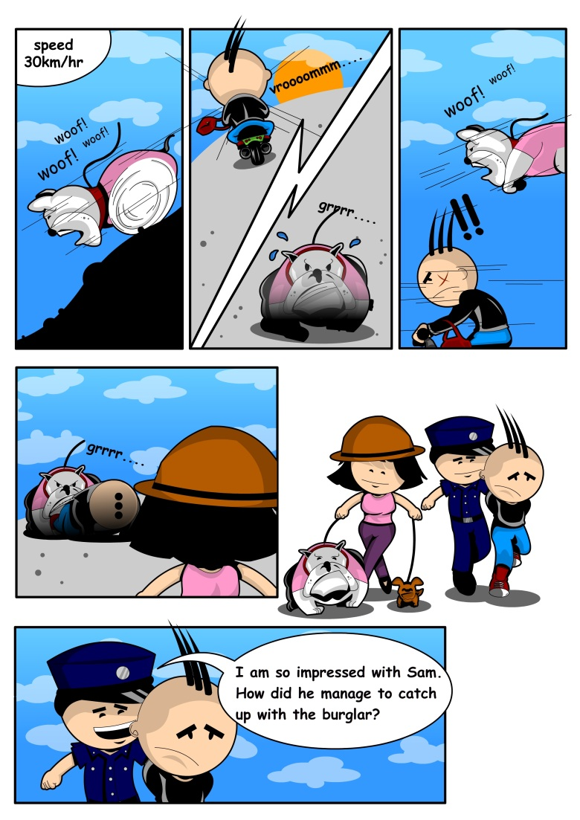
Mathematics in Context

Slide 26
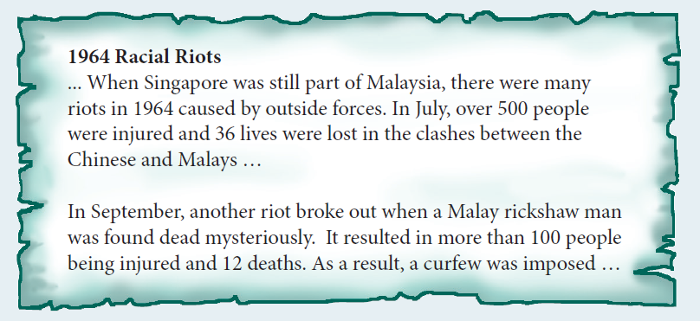
Mathematics in Context
National Education …
Notes:
Mathematics in context can be used in National Education.

Slide 27
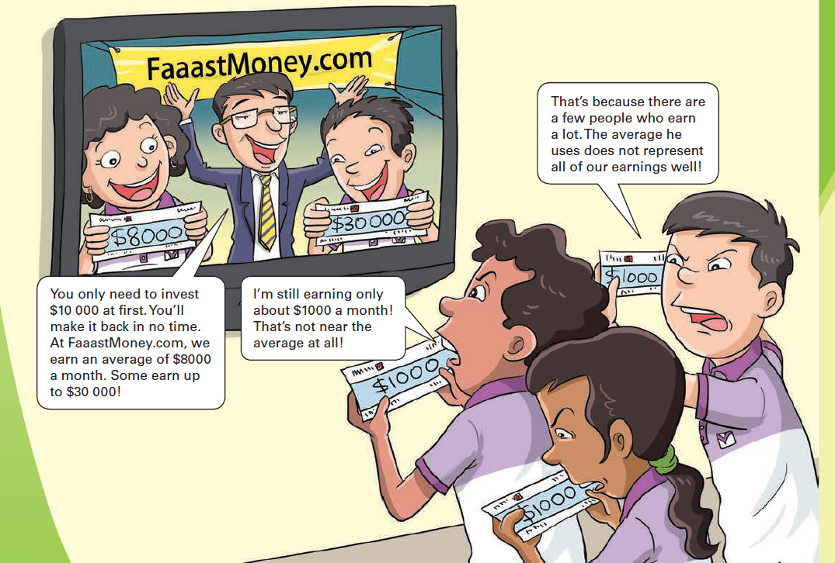
Mathematical Reasoning
What is relevant to everyday live
Notes:
Mathematical Reasoning can also be contextualized.

Slide 28
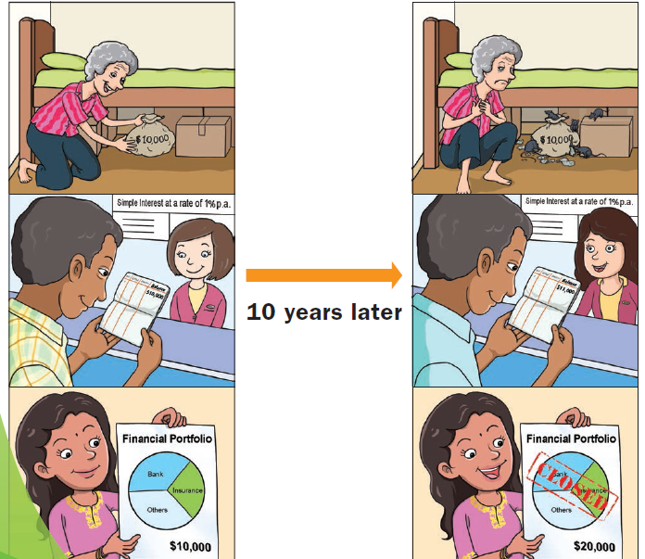
Mathematical Reasoning
Financial Literacy
Notes:
Mathematical Reasoning can also be contextualized.

Slide 29
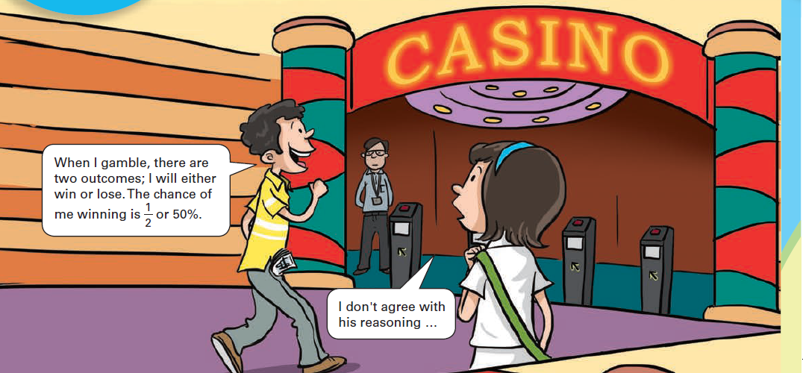
Mathematical Reasoning
Critical mathematical reasoning…

Slide 30
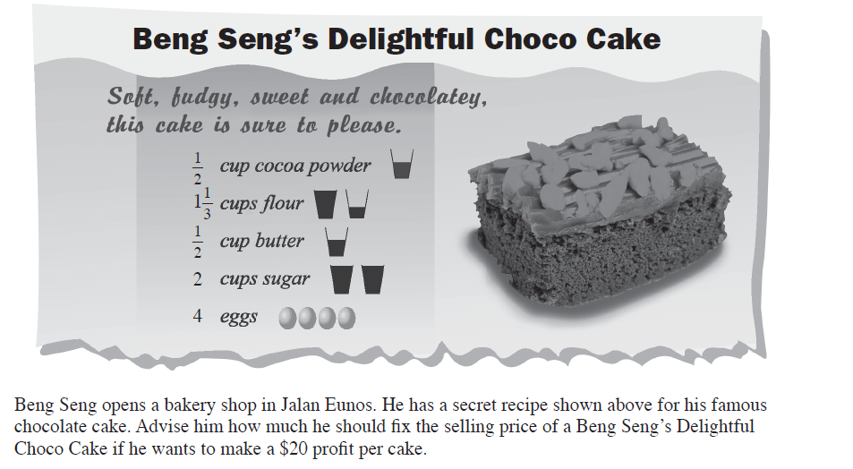
Application of Mathematics
Notes:
Next level: application of mathematics.

Slide 31
Application of Mathematics
Oops… need to make profit.
Need to find the cost price of the various ingredients.
Needs knowledge of the world
Needs to know the type of data to collect.
Scaffold provided to guide the students?
Notes:
Need to know: what is profit? What data to look for? Teachers can provide different levels of scaffold.

Slide 32
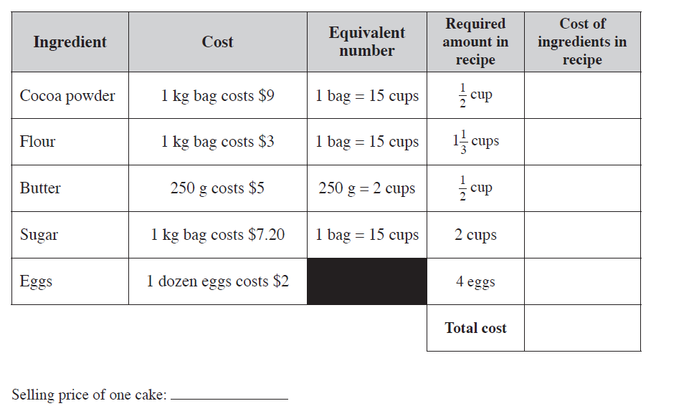
Application of Mathematics
Notes:
E.g. provide the cost in the recipe will drastically reduce the work of “data collection”

Slide 33
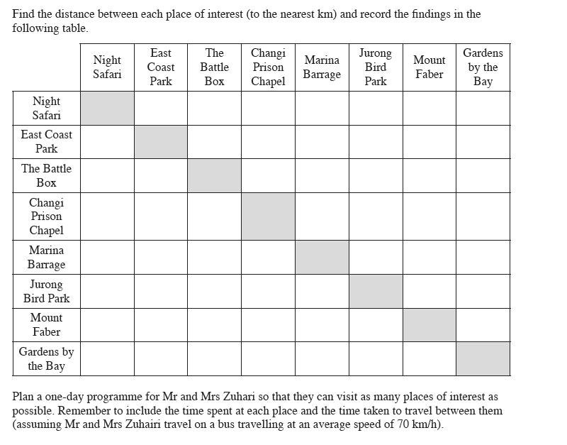
Application of Mathematics
Notes:
Next task: involve more in data collection. Need to know that in scheduling a visit, need to know distance, speed, and other common sense knowledge, e.g. need time to explore each place of visit. These are knowledge about the world (contextual knowledge).

Slide 34
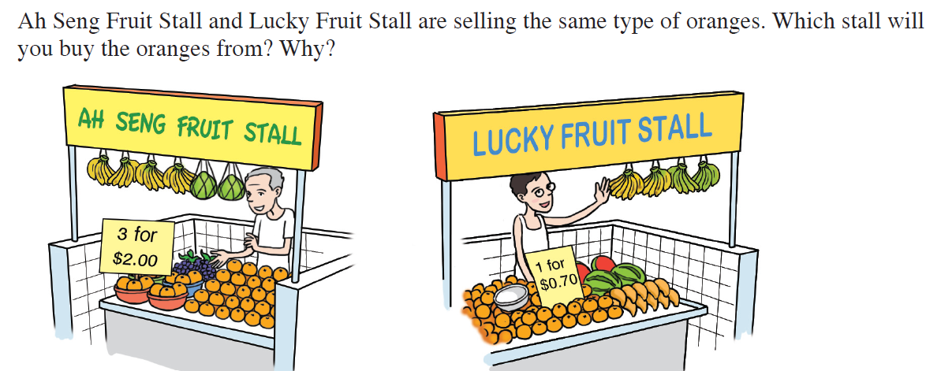
Application of Mathematics
Whenever real-world context is brought into a problem, the answer may not be unique…
Notes:
Note that answers may not be unique anymore.

Slide 35
Making Decisions using Mathematics
Woodlands
10000
10000
12000
12000
Yishun
Yishun
15000
15000
Choa Chu Kang
Choa Chu Kang
13000
13000
16000
16000
Ang Mo Kio
11000
Ang Mo Kio
11000
16000
16000
Pasir Ris
6000
9000
6000
9000
Jurong East
Toa Payoh
5000
Toa Payoh
Tampines
11000
Tampines
11000
10000
9000
10000
9000
Clementi
Clementi
11000
Aljunied
11000
10000
Aljunied
10000
6000
6000
13000
13000
Queenstown
Queenstown

Slide 36
Making Decisions using Mathematics
The Singapore government wants to ensure that all the housing estates are connected with their pipes. The cost of building the pipes are shown. How would you advise the government to connect all the housing estates?
To minimize the cost, while keeping all the housing estates connected

Slide 37
Making Decisions using Mathematics
Prim’s Algortihm
Start a starting vertex
Connect it to the nearest vertex
Connect the next “nearest” vertex
Repeat the process until all the vertices are connected.

Slide 38
Making Decisions using Mathematics
Kruskal’s Algorithm
Start with the smallest edge.
Repeat the next edge with smallest edge; include this if it does not form a cycle, and exclude this if it forms a cycle.
Repeat this process after all the edges are included.

Slide 39
Making Decisions using Mathematics
The idea is NOT to teach students to memorize these algorithms, but to develop these (and even other) algorithms on their own.
Our main objective is to empower students to learn, create their own understanding instead of traditional memorizing of standard knowledge.
They need to have knowledge of the real world – contextual knowledge.

Slide 40
Making Decisions using Mathematics
Hexagon instead of Pentagon?

Slide 41
Conclusion
In Context, Application, Making Decisions → all these activities need students to have the knowledge of the real world (contextual knowledge).
Important steps of mathematical modelling

Slide 42
Movie…

